Slide 1

Name : G.SHASHANK Registration Number : 12103668 Name : A.DILLEP KUMAR Registration Number : 12112870 Program : CSE BTECH (AI AND ML) Semester : 2 School : School of Computer Science And Engineering Name of the University : Lovely Professional University Date of submission : 23 APRIL 2022 Lovely Professional University Jalandhar, Punjab, India
REPORT FOR BLOOD BONATION
COURSE CODE : CSE 326

Slide 2
ABSTRACT:
“Blood” one of the most important necessity of our life. The numbers of blood donor is very less when compared with other countries. In our project we propose a new and efficient way to overcome such outline. Such as just touch the button donor will be ask to enter an individual's details like name, phone number, age, weight, date of birth, blood group, address etc. If the donor accept the request then an one time password (OTP) will be send to the donor to verify. Blood donation app provider list of donor in your city/area. Once the donor donate the blood it will automatically remove the donor detail for next three months.
ACKNOWLEDGEMENT:
I would like to thank my mentor – MD Imran hussain for his advice and inputs on this project. Many thanks to my friends and parents as well, who spent countless hours to listen and provide feedbacks

Slide 3
TABLE OF CONTENTS
 | PAGE NO
ABSTRACT | 2
INTRODUCTION | 4
TEAM MEMBERS | 5
MAIN CODE | 6-10
SUB CODE | 11-23
IMAGES | 24
CSS CODE | 25-26
ABOUT BLOOD DONATION | 27
CONCLUSION AND REFERENCE | 28

Slide 4
INTRODUCTION:- 1. Context : This project has been done as part of my course for the CSE at Lovely Professional University . Supervised by Imran Hussain sir. 2. Motivations: Being extremely interested in everything having a relation with the Machine Learning, the group project was a great occasion to give us the time to learn and confirm our interest for this field. We can use programming in Finance, Medicine, almost everywhere. That’s why I decided to conduct my project int HTML.. 3. Idea: As a first experience, we wanted to make my project as much didactic as possible by approaching every different steps of the HTML programming process and trying to understand them deeply. Known as ” toy problem” the problems that are not immediate scientific interest but useful to illustrate and practice, we chose to take house price Prediction as approach. The goal was to predict the price of a given house according to the market prices taking into account different “features” that will be developed in the following .

Slide 5
TEAM MEMBERS:- G.SHAHSANK:- Contributions:- 1. Coding(joined) 2. Report 3.Guidance A.DILLEP KUMAR:- Contributions:- 1. Coding(joined) 2. Gathering information

Slide 6
<!DOCTYPE html>
<html>
<head>
<title>Donate Blood</title>
<meta http-equiv="refresh" >
<link rel="stylesheet" type="text/css" href="style.css">
</head>
<body>
<h2>Blood Donation</h2>
<div>
<div class="first">
<h3>BloodBank.com</h3>
<h3>A Social Intiative</h3>
<div class="Login"><form>
<label for="username">DONOR LOGIN</label>
<input type="text" name="username" id="username">
<label for="password"> PASSWORD</label>
<input type="password" name="password" id="password">
<button type="submit" value="submit">LOGIN</button>
</form>
</div>
</div>
<div class="menubar">
<a href="registration.html">Register</a>
<a href="why donate blood.html">Why Donate Blood</a>
<a href="who can give blood.html">Who can give Blood</a>
<a href="https://web.whatsapp.com/">Refer A friend</a>
<a href="contact us.html">Contact Us</a>
</div>
MAIN CODE

Slide 7
<div class="findDonorAndImage">
<div class="findDonor" >
<h4>Find A DONOR</h4>
<td><select>
<option selected disabled>---select state---</option>
<option>AP</option>
<option>PUNJAB</option>
<option>TS</option>
<option>UP</option>
<option>MAHARASTRA</option>
<option>MP</option>
<option>JAMMU</option>
<option>DELHI</option>
</select><br><br>
<select>
<option selected disabled>---select city---</option>
<option>VISAKHAPATNAM</option>
<option>CHANDIGARH</option>
<option>HYDERABAD</option>
<option>LUCKNOW</option>
<option>MUMBAI</option>
<option>BHOPAL</option>
<option>SRINAGAR</option>
<option>NEWDELHI</option>
</select><br><br>

Slide 8
<select>
<option selected disabled>---select area---</option>
<option>AKKAYYAPALEM</option>
<option>DONDAPARTHI</option>
<option>JUBILEEHILLS</option>
<option>RAMAKRISHNAROAD</option>
<option>RUSHIKONDA</option>
<option>MAMIDITHOTA</option>
<option>DABAGARDENS</option>
<option>TEMPLEROAD</option>
</select><br><br>
<select>
<option selected disabled>---select group---</option>
<option>AB+</option>
<option>AB-</option>
<option>O+</option>
<option>O-</option>
<option>A+</option>
<option>A-</option>
<option>B+</option>
<option>B-</option>
</select><br><br>
<input type ="search" value="search"></td>
</div>
<img src="blood.gif">
</div>

Slide 9
<div class="donationProcess">
<h3>Donation Process</h3>
<ul>
REGISTRATION
We’ll sign you in and go over basic eligibility.
You’ll be asked to show ID, such as your driver’s license.
You’ll read some information about donating blood.
</ul>
<ul>
HEALTH HISTORY
You’ll tell us about any prescription and/or over the counter medications that may be in your system.
We’ll check your temperature, pulse, blood pressure and hemoglobin level.
</ul>
<ul>
YOUR DONATION
If you’re donating whole blood, we’ll cleanse an area on your arm and insert a brand new sterile needle for the blood draw. (This feels like a quick pinch and is over in seconds.)
Other types of donations, such as platelets, are made using an apheresis machine which will be connected to both arms.
A whole blood donation takes about 8-10 minutes, during which you’ll be seated comfortably or lying down.
</ul>
<ul>
REFRESHMENT AND RECOVERY
After donating blood, you’ll have a snack and something to drink in the refreshment area.
You’ll leave after 10-15 minutes and continue your normal routine.
Enjoy the feeling of accomplishment knowing you are helping to save live
</div>
<div class="donationPlace">
<h4>Where would you like to Donate?</h4>
<input type="text" name="place" id="place" size="100">
<button>Search</button>
</div>
<form action="Give feedback.html">
<button class="feedBack">Give Feedback</button>
</form>
</div>
</body>
</html>

Slide 10
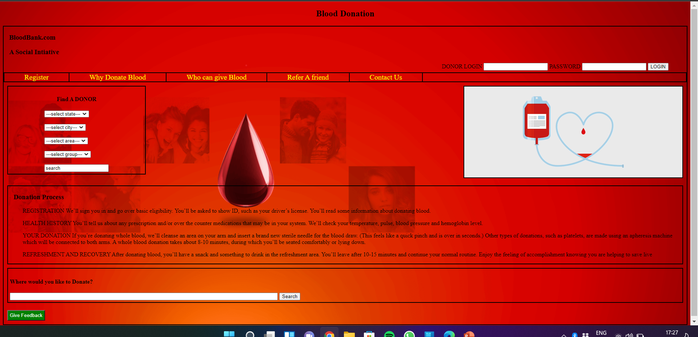
MAIN CODE OUTPUT

Slide 11
SUB CODES: 1 REGISTER 2 WHY DONATE BLOOD 3 WHO AN GIVE BLOOD 4 REFER A FRIEND 5 CONTACT US 6 FEED BACK

Slide 12
REGISTER CODE
<html>
<head>
<title>Register</title>
<style>
body{
background-image: url('registration.jpg');
background-size:cover;
}
</style>
</head>
<body>
<form>
<font face="ariel" size="5px" color="red">
<label for="fname">FIRST NAME : </label><BR>
<input type="text" id="fname" name="fname"><br><br>
</font>
<font face="ariel" size="5px" color="pink">
<label for="fname">MIDDLE NAME : </label><BR>
<input type="text" id="mname" name="mname"><br><br>
</font>
<font face="ariel" size="5px" color="orange">
<label for="lname">LAST NAME : </label><br>
<input type="text" id="lname" name="lname"><br><br>
</font>
<font face="ariel" size="5px" color="blue">
<label for="lname">AGE : </label><br>
<input type="text" id="age" name="age"><br><br>
</font>

Slide 13
<font face="ariel" size="5px" color="green">
<label for="lname">EMAIL : </label><br>
<input type="text" id="email" name="email"><br><br>
</font>
<font face="ariel" size="5px" color="violet">
<label for="lname">CONTACT : </label><br>
<input type="text" id="contact" name="contact"><br><br>
</font>
</form>
<font face="ariel" size="5px" color="blue">
<input type="radio" name="gender" id="male">
<label for="male">male</label>
<input type="radio" name="gender" id="female">
<label for="female">female</label><br><br>
</font>
<form><input type="submit"></form>
</body>
</html>

Slide 14
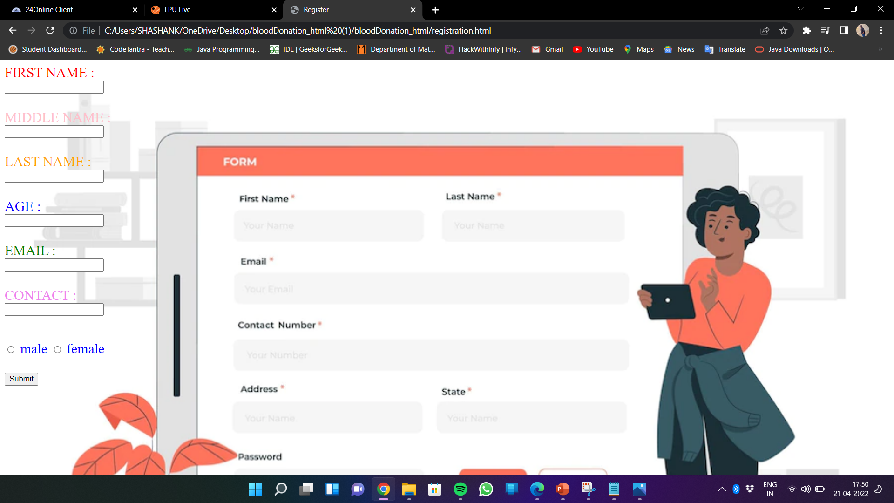
REGISTER

Slide 15
<html>
<head>
<body>
<font face="ariel" size="5px" color="blue">
<p>A blood donation is truly an altruistic gift that an individual can give to others in need. In only 45-60 minutes, an eligible individual can donate one unit of blood that
can be separated into four individual components
that could help save multiple lives.</p><br>
<p>There is a constant need for a regular supply of blood because it can be stored only
for a limited period of time before use. Regular blood donation by a sufficient number
of healthy people is needed to ensure that blood will always be available whenever and
wherever it is needed.</p><br>
<p>Blood is the most precious gift that anyone can give to another
person – the gift of life. A decision to donate your blood can save a life, or even
several if your blood is separated into its components – red cells, platelets and plasma
– which can be used individually for patients with specific conditions.</p><br>
<p>Why is it Important to Donate Blood?
About 328 million people currently live in the U.S.
WHY DONATE BLOOD CODE

Slide 16
Each year, approximately 6.8 million people in the U.S donate blood. Annually, this adds up to about 13.6 million units of whole blood collected for donation in the U.S.
The Red Cross provides about 40% of our nation’s blood and blood cell components to donors.Your blood donations are used for patients in need of surgery, cancer treatment and transfusions for blood loss
from traumatic injuries.</p><br>
<p>From one unit of blood, red blood cells can be extracted and used to treat patients who lost blood due to trauma or those who are recovering from surgery. Plasma, the liquid part of blood, is typically
administered to patients with requiring treatment to
improve blood clotting. Platelets, a third component, clot the blood when cuts or other open wounds occur, and are often used in the treatment of patients with cancer or those undergoing organ transplants.
Finally, cryoprecipitated anti-hemophilic factor
(AHF) is also used for clotting factors.</p>
</font>
<style>
body{
background-image: url("hands.jpg");
background-size:cover;
}
</style>
</body>
</head>
</html>

Slide 17
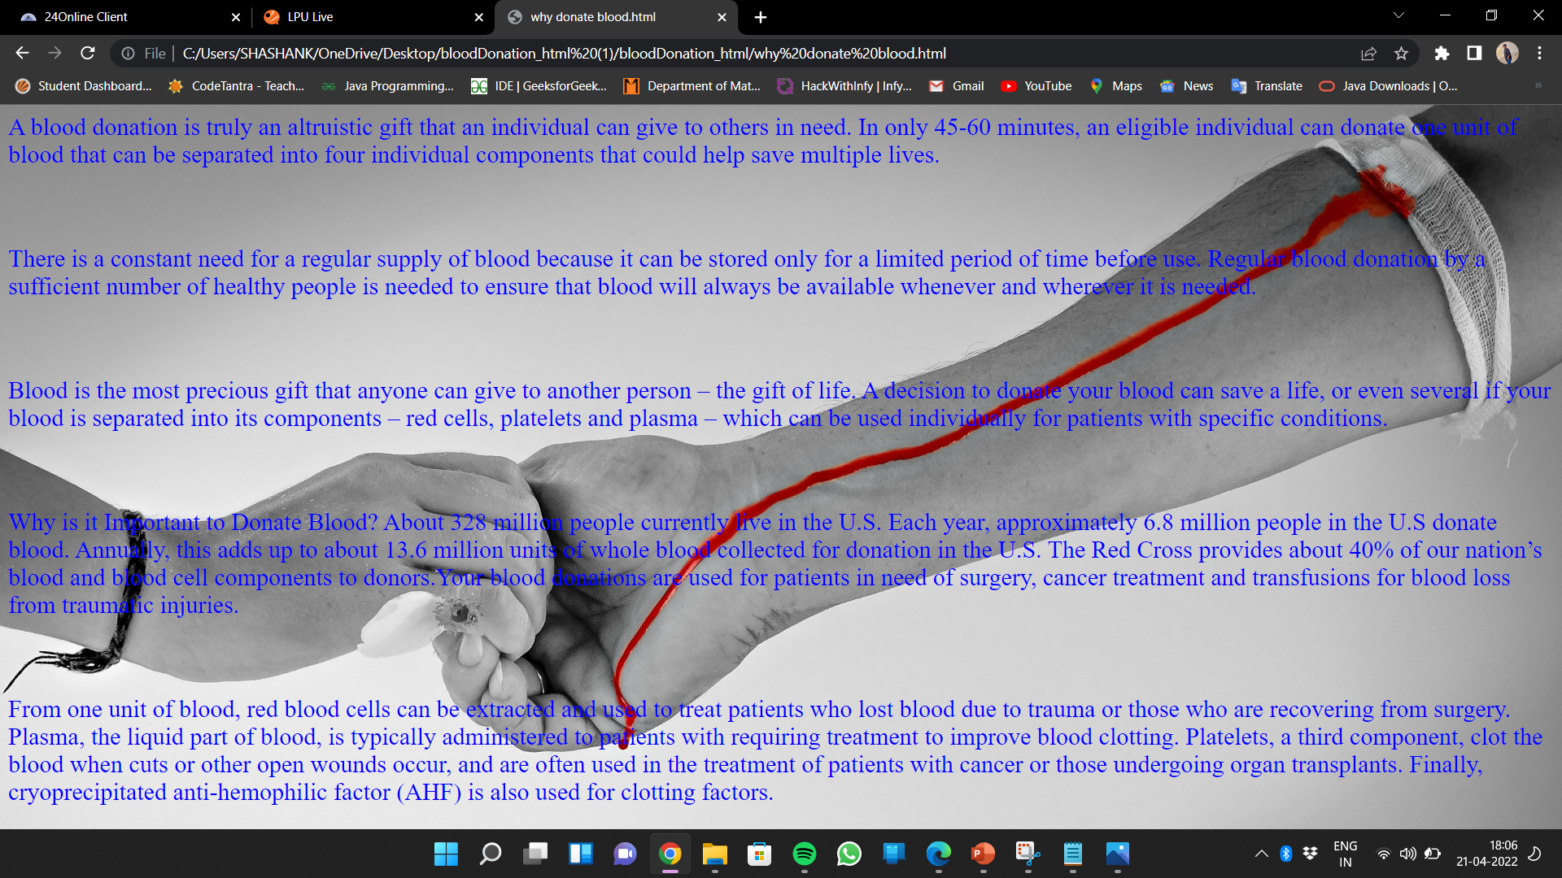
WHY DONATE BLOOD
A

Slide 18
<html>
<head>
<body>
<style>
body{
background-image: url("2.jpg");
background-size:cover;
}
</style>
<h1 style="color:red;">AGE</h1>
<font face="ariel" size="5px" color="blue">
You are aged between 18 and 65.
In some countries national legislation permits 16–17 year-olds to donate provided that they fulfil the physical and hematological criteria
required and that appropriate consent is obtained.
In some countries, regular donors over the age of 65 may be accepted at the discretion of the responsible physician.
The upper age limit in some countries are 60.
</font><br><br>
<h1 style="color:orange;">WEIGHT</h1>
<font face="ariel" size="5px" color="green">
You weigh at least 50 kg.
In some countries, donors of whole blood donations should weigh at least 45 kg
to donate 350 ml ± 10%
</font> <br><br>
WHO CAN GIVE BLOOD CODE

Slide 19
<h1 style="color:yellow;">HEALTH</h1>
<font face="ariel" size="5px" color="pink">
You must be in good health at the time you donate.
You cannot donate if you have a cold, flu, sore throat, cold sore, stomach bug or any other infection.
If you have recently had a tattoo or body piercing you cannot donate for 6 months from the date of the procedure.
If the body piercing was performed by a registered health professional and any inflammation has settled completely, you can donate blood after 12 hours.
If you have visited the dentist for a minor procedure you must wait 24 hours before donating; for major work wait a month.
You must not donate blood If you do not meet the minimum haemoglobin level for blood donation:
A test will be administered at the donation site. In many countries, a haemoglobin level of not less than 12.0 g/dl for females and not less than 13.0 g/dl for males as the threshold.
</font>
</body>
</head>
</html>

Slide 20
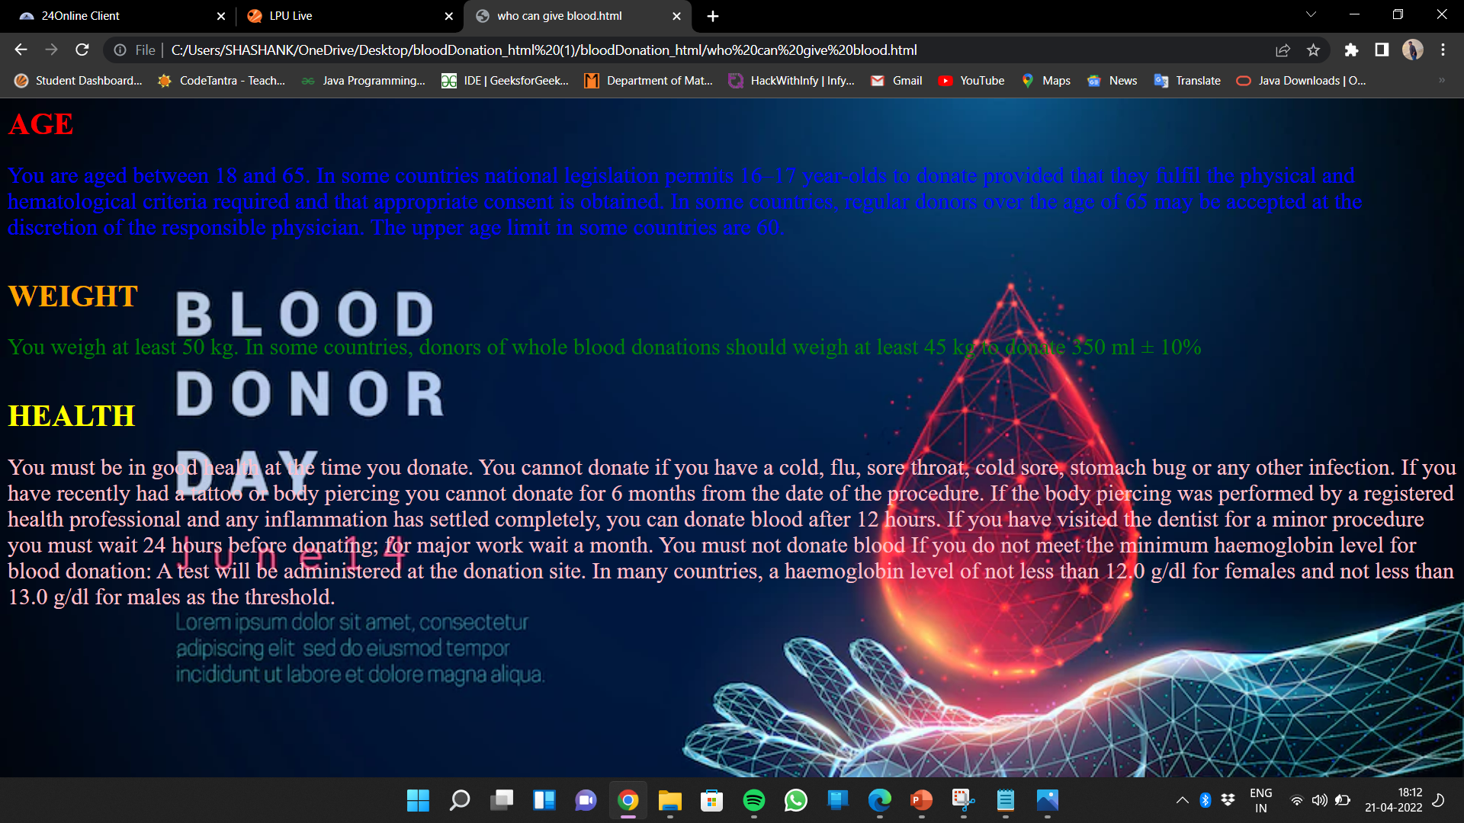
WHO CAN GIVE BLOOD

Slide 21
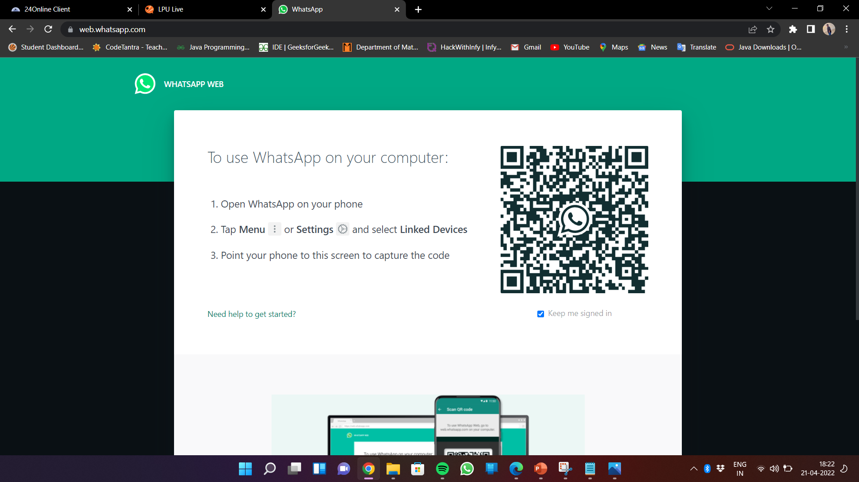
REFER A FRIEND

Slide 22
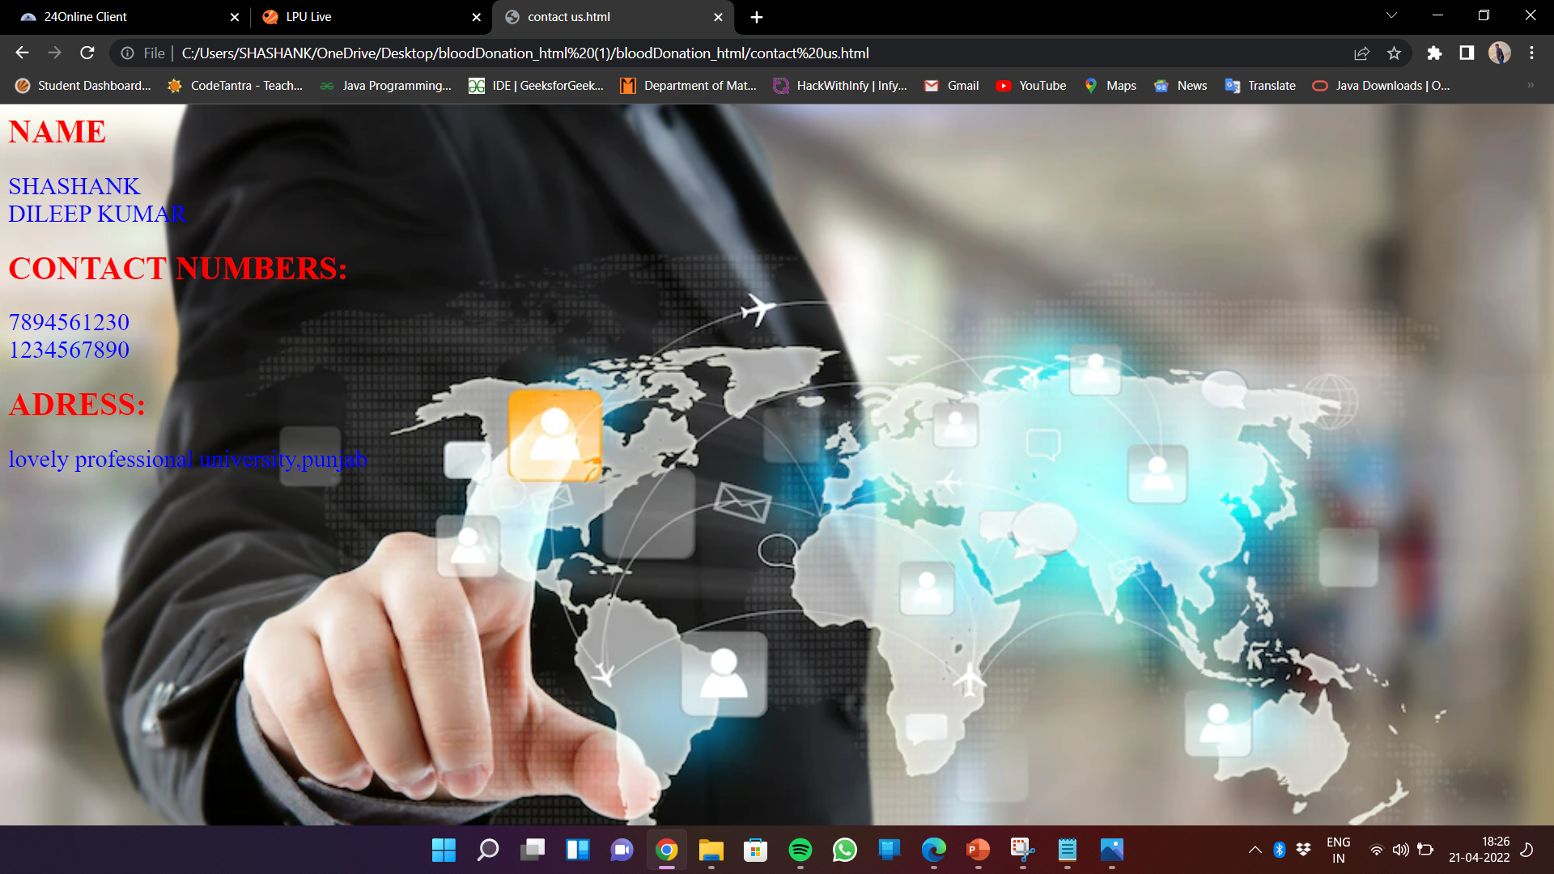
CONTACT US CODE
<html>
<head>
<body>
<style>
body{
background-image: url("contact.jpg");
background-size:cover;
}
</style>
<h1 style="color:red;">NAME</h1>
<font face="ariel" size="5px" color="blue">
SHASHANK<br>DILEEP KUMAR
</font><br>
<h1 style="color:red;">CONTACT NUMBERS:</h1>
<font face="ariel" size="5px" color="blue">
7894561230<br>1234567890
</font><br>
<h1 style="color:red;">ADRESS:</h1>
<font face="ariel" size="5px" color="blue">
lovely professional university,punjab
</font><br>
</p>
</body>
</head>
</html>

Slide 23
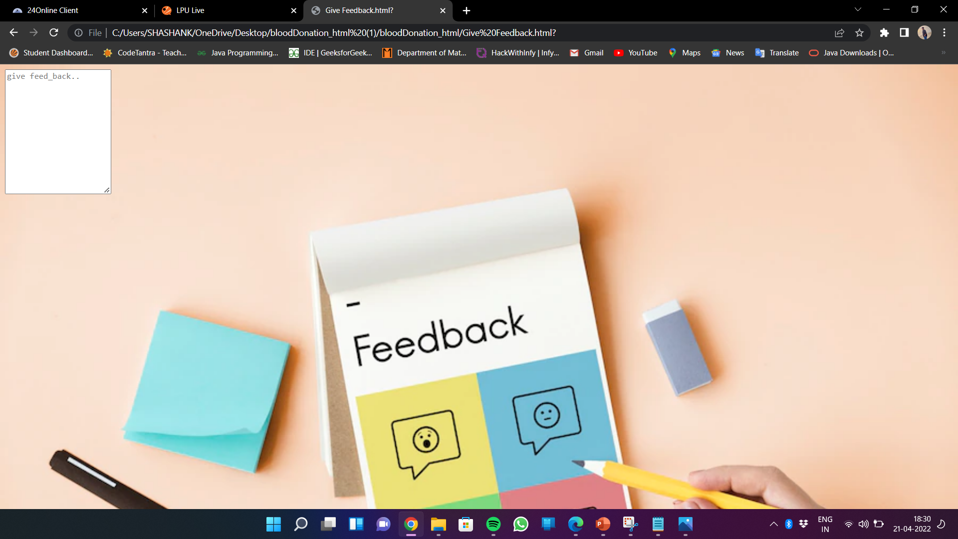
FEED BACK CODE
<html>
<head>
<style>
body{
background-image: url('feedback.jpg');
background-size:cover;
}
</style>
</head>
<body>
<tr>
<td colspan="50"><label for="feed_back"></label>
<textarea id="subject" name="subject" placeholder="give feed_back.." style="height:200px" ></textarea>
</td>
</tr>
</body>
</html>

Slide 24

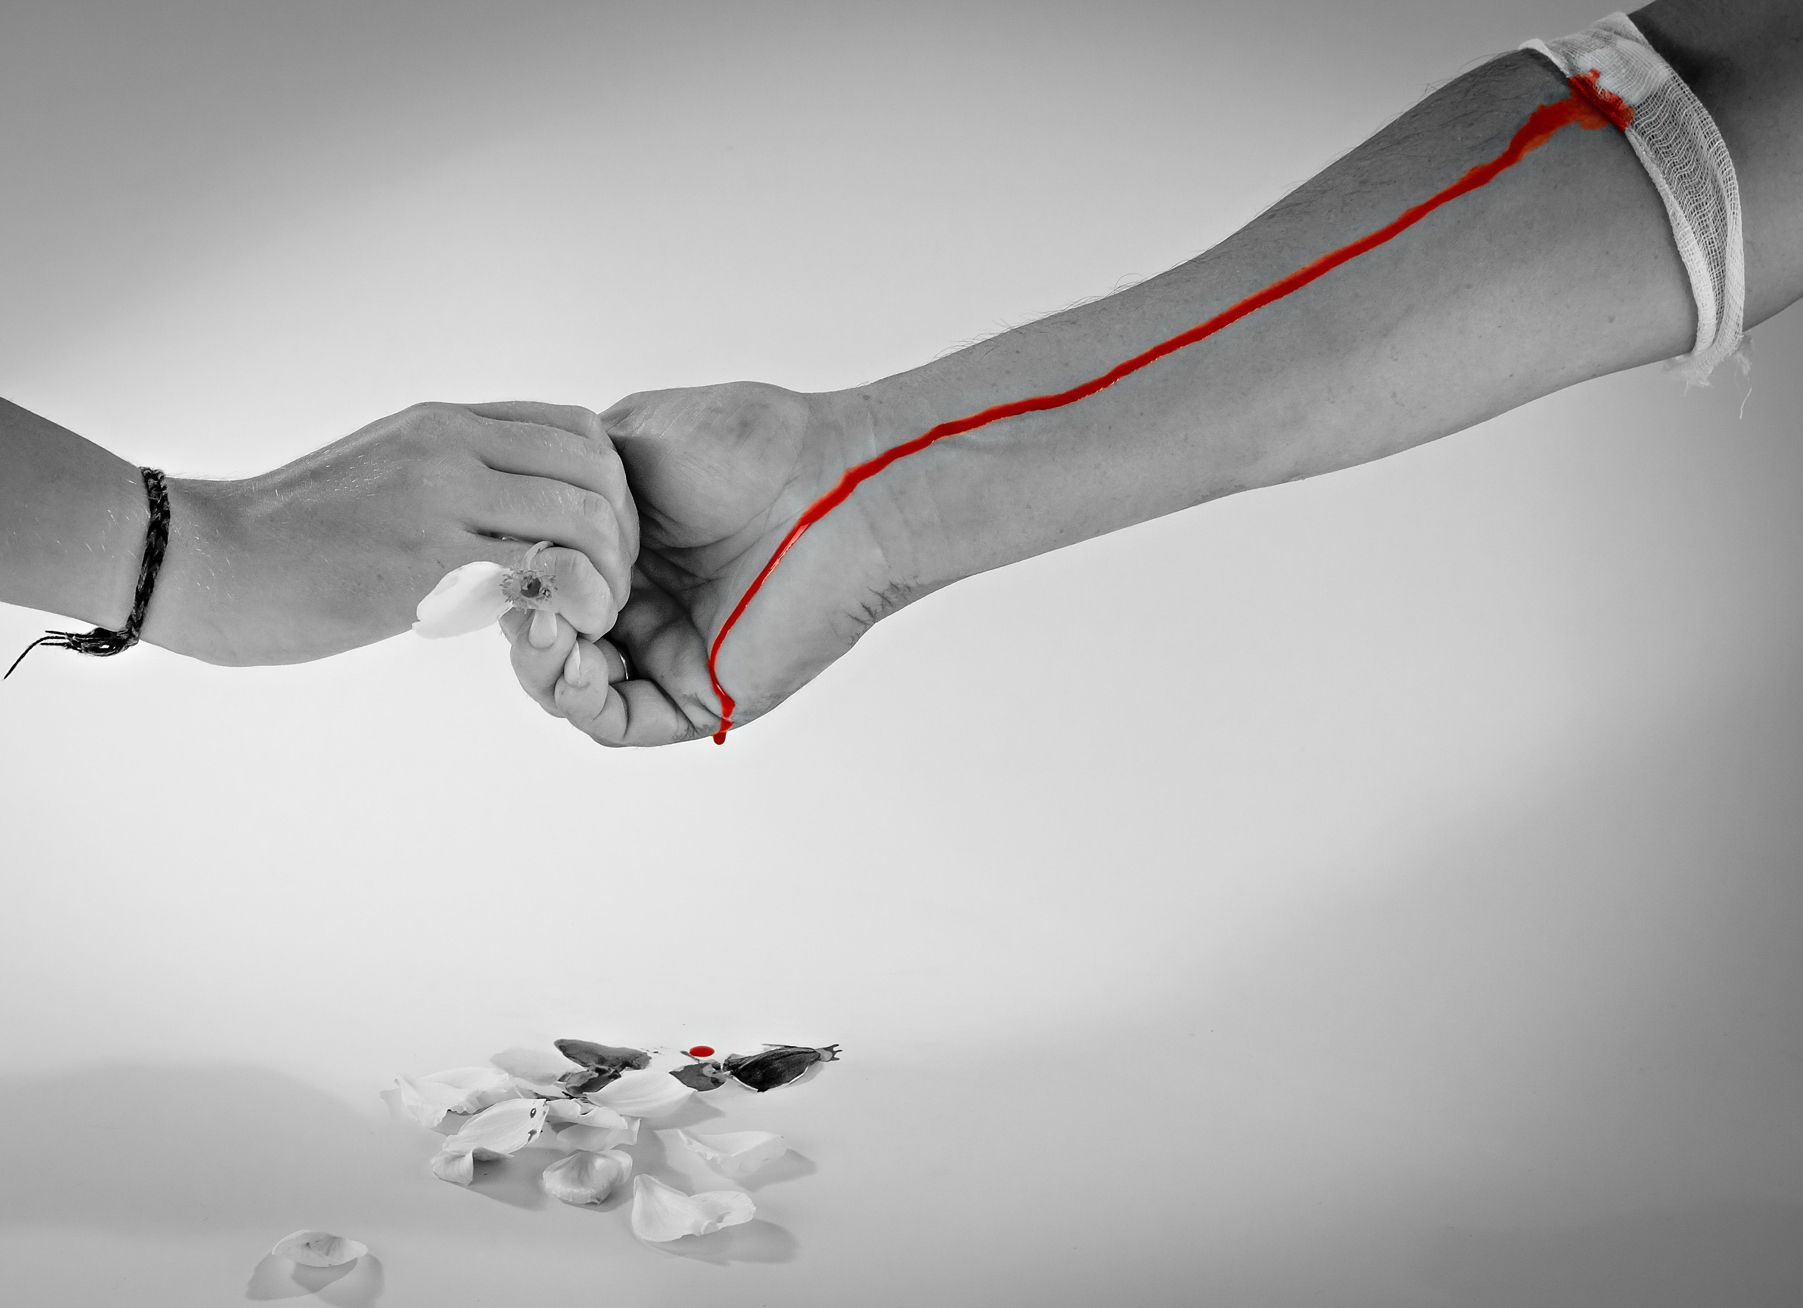
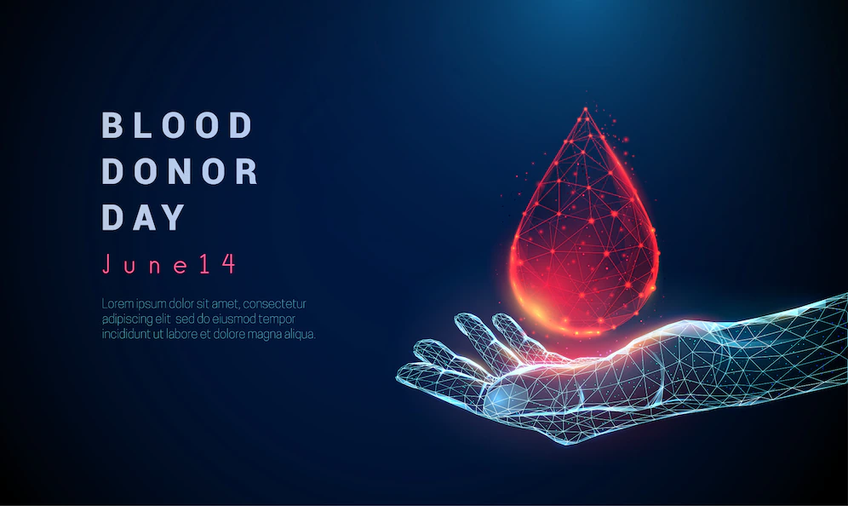
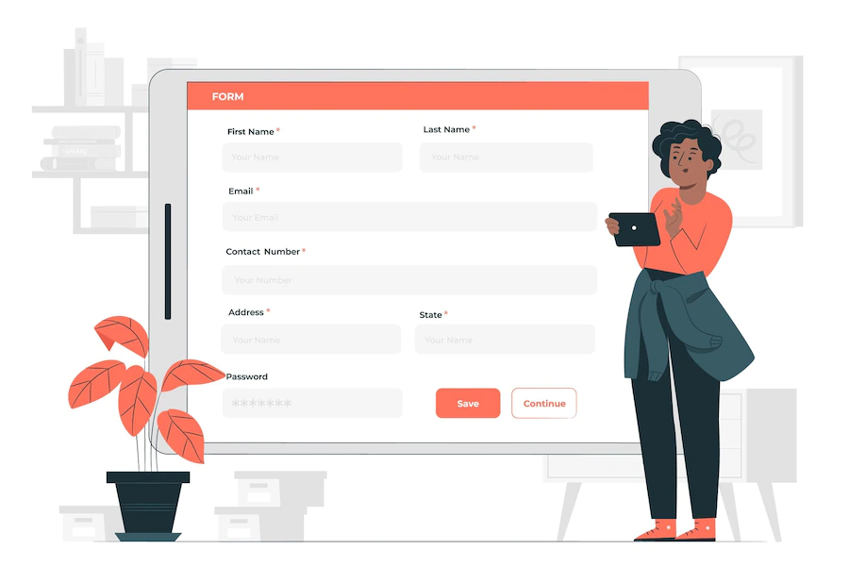
IMAGES

Slide 25
CSS CODE
div{
overflow: hidden;
border:2px solid black;
}
body{
background-image: url("bg.png");
background-size: cover;
}
h2{
text-align: center;
}
.first{
border:none;
}
.Login{
border:hidden;
float: right;
margin-left: 10%;
padding:0 50px 5px 0;
}
.menubar{
display: flex;
}
.menubar >a{
text-decoration: none;
font-size: 20px;
padding: 0 55px;
border-right:2px solid black;
color: yellow;
}
a:hover{
text-decoration: underline;
}

Slide 26
.findDonor{
border:2px solid black;
float: left;
padding: 5px 100px;
margin: 10px;
}
.findDonor > h4{
text-align: center;
}
img{
float: right;
width: 600px;
height: 250px;
border : 2px solid black;
margin: 10px;
}
.findDonorAndImage{
border:hidden;
}
.donationProcess{
margin: 10px;
}
h3{
padding-left: 15px;
}
.donationPlace{
margin: 10px;
padding: 5px 5px;
}
.feedBack{
background-color: green;
color: white;
padding: 5px;
margin: 10px;
}

Slide 27
ABOUT BLOOD DONATION
Blood donation occurs when a person voluntarily has blood drawn and used for transfusions and/or made into biopharmaceutical medications by a process called fractionation (separation of whole blood components). Donation may be of whole blood, or of specific components directly (apheresis). Blood banks often participate in the collection process as well as the procedures that follow it.
Today in the developed world, most blood donors are unpaid volunteers who donate blood for a community supply. In some countries, established supplies are limited and donors usually give blood when family or friends need a transfusion (directed donation). Many donors donate for several reasons, such as a form of charity, general awareness regarding the demand for blood, increased confidence in oneself, helping a personal friend or relative, and social pressure. Despite the many reasons that people donate, not enough potential donors actively donate.

Slide 28
CONCLUSION majority of the donors were willing to be regular donors. The donors showed positive effects like a sense of satisfaction after the donation. Creating an opportunity for blood donation by conducting many blood donation camps may increase the voluntary blood donations. REFERENCES W3 SCHOOLS GEEK FOR GEEKS WIKIPEDIA

Slide 29
THANK YOU
S

